Slide 1
Bottle Rocket Modeling
Cole MacPherson and Ankrit Uprety

Slide 2
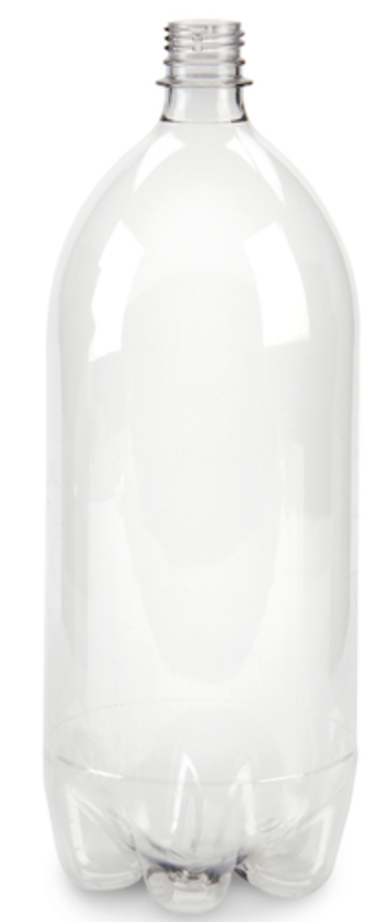

Introduction
Objective: To model the trajectory of the bottle rocket launch, using numerical integration of a system of ordinary differential equations.
Background:
- How it works
- Relevance

Slide 3
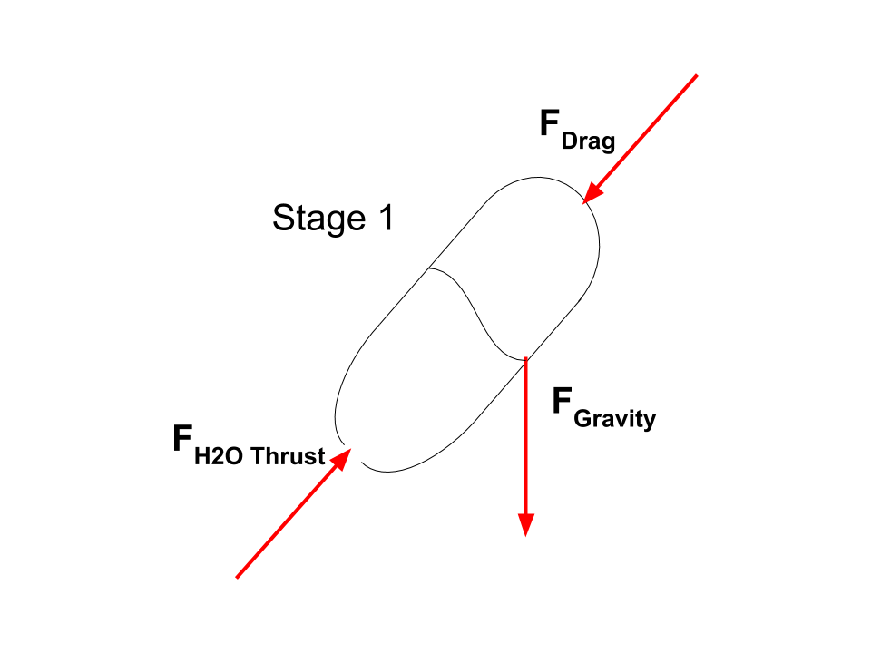

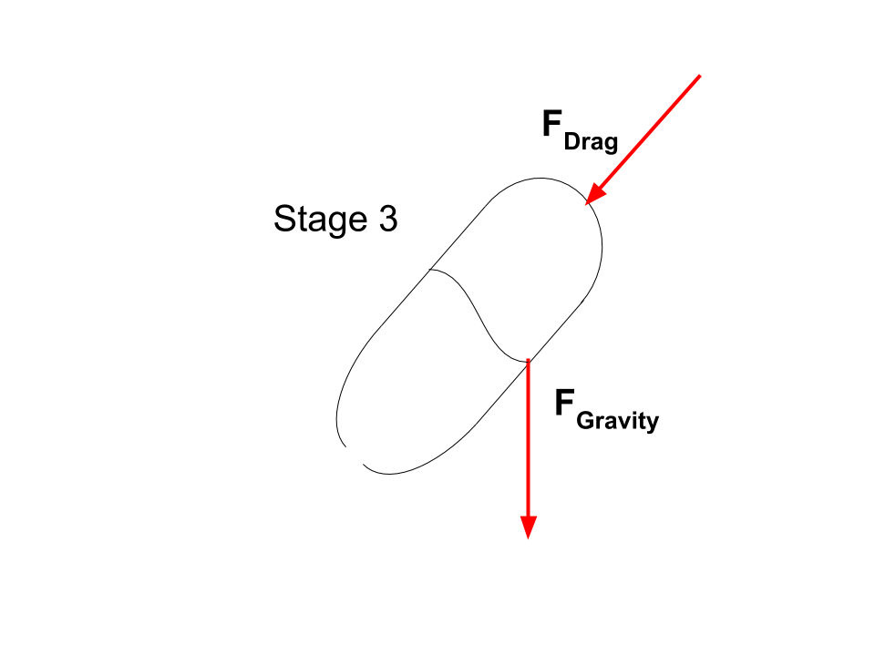
Methodology
Purpose: Understanding the effects specific parameters have on a bottle rocket
Given: Equations and variables
Required: Model a bottle rocket that will travel 80m horizontally
Assumptions: Drag is acting from the top of the bottle, no torque, no wind, no friction
Schematics: 3 stages of the bottle rocket

Slide 4
Methodology
6. Fundamental Principles: Thrust and drag forces, stage 1 end, stage 2 end, and choked flow
7. Alternative Approaches: Creating 3 separate functions for each phase
8. Procedure: Function for ode45. Function for getting thrust. Plotting the graphs/verifying the code. Change values to reach 80m.
9. Cross Check: Verification Test.
10. Reality check: Discussed later.

Slide 5
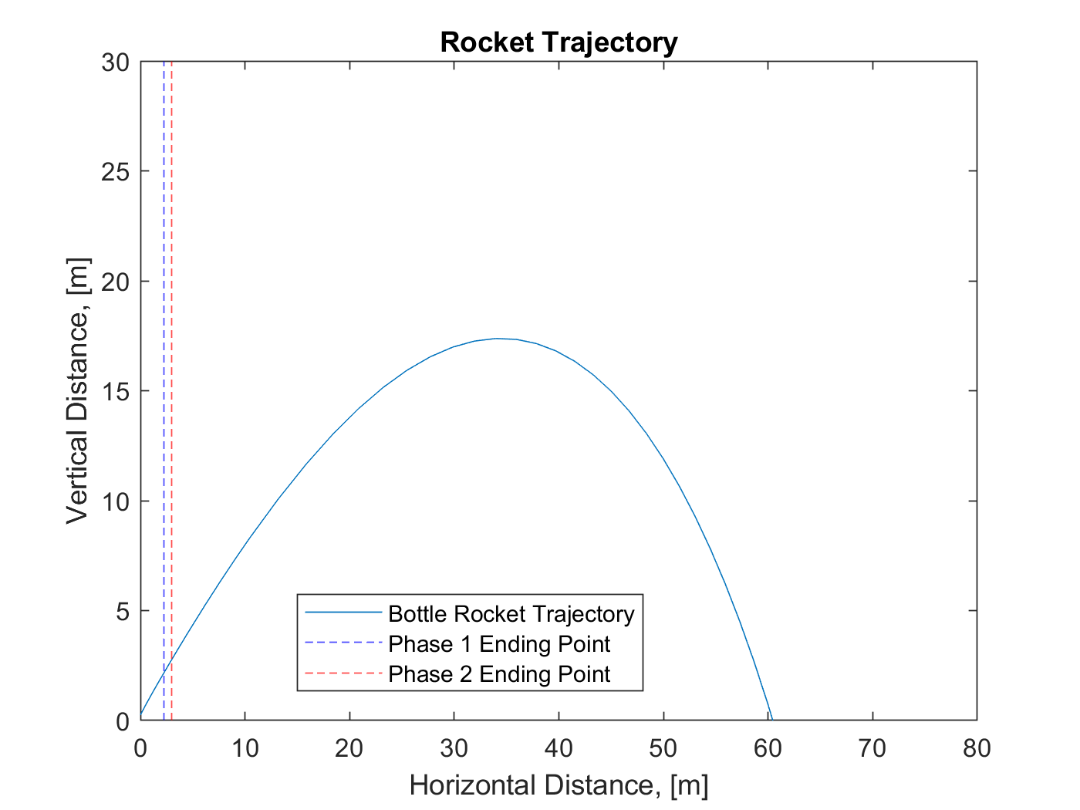
Results- Verification Test
Maximum Height: 17.37 m
Maximum Distance: 60.45 m

Slide 6
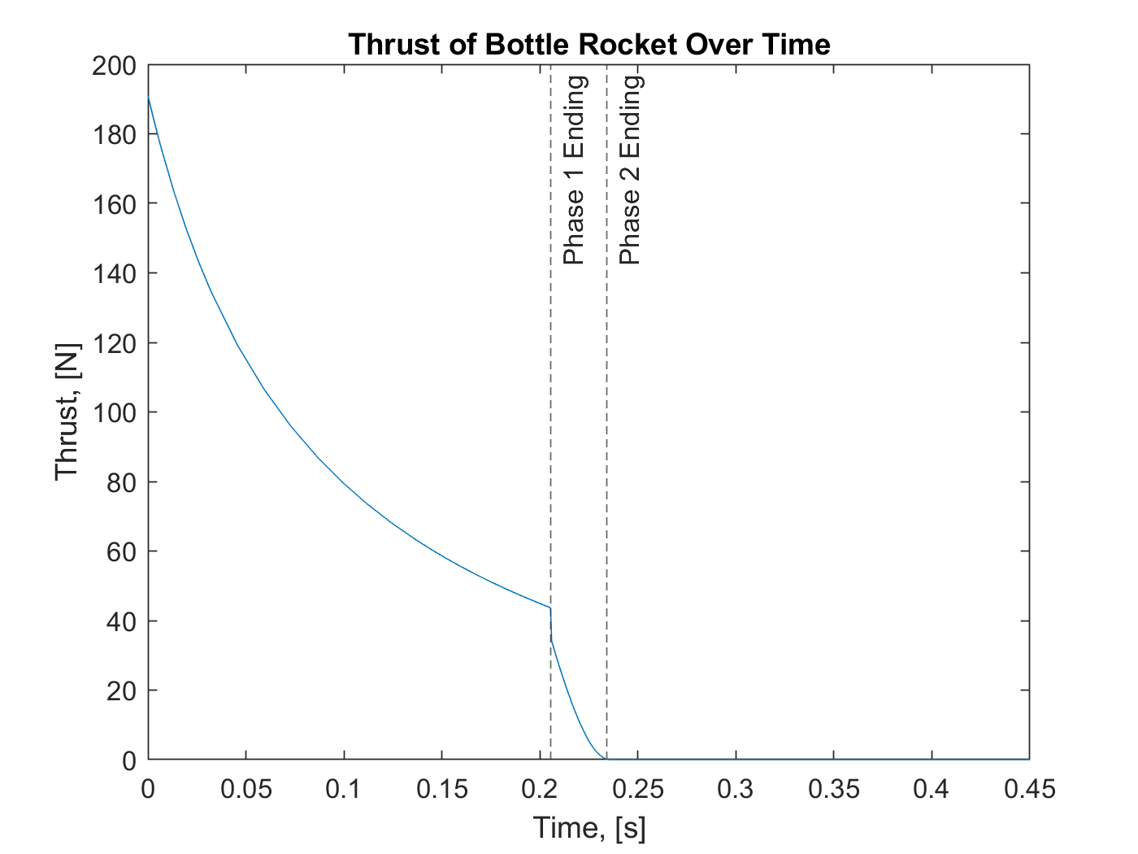
Results - Verification Test

Slide 7
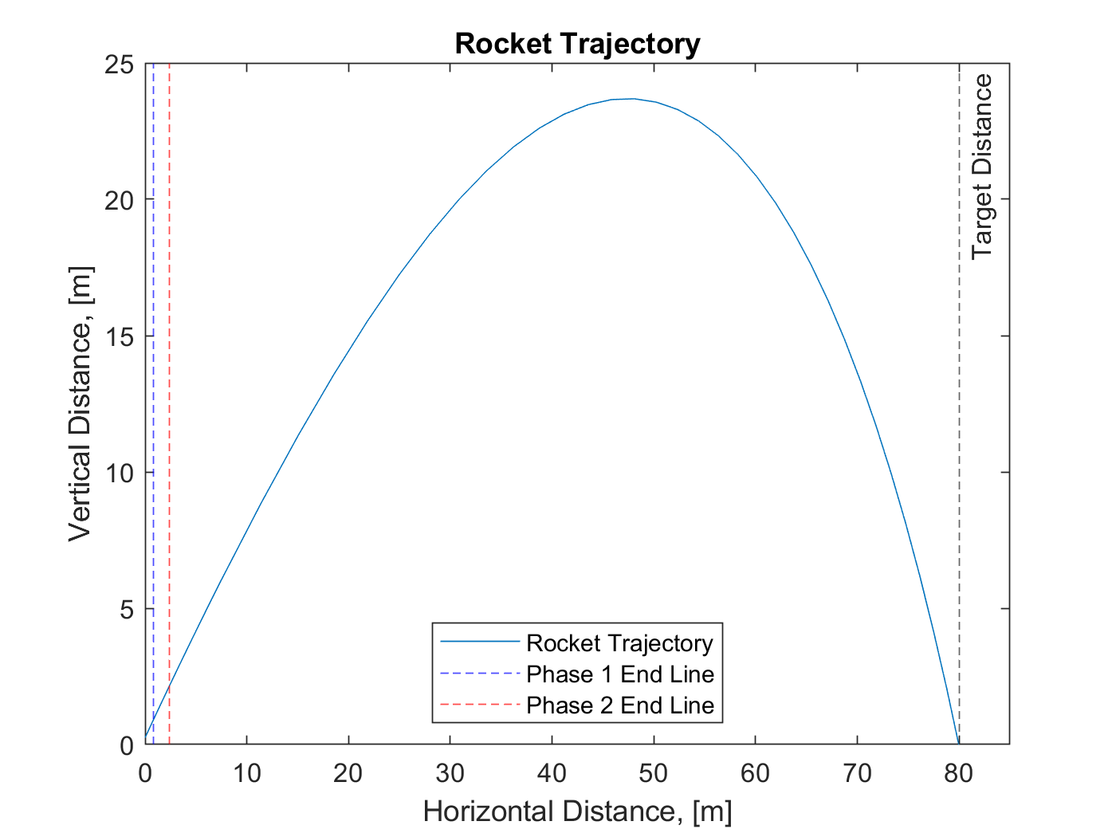
Results
Maximum Height: 23.69 m
Maximum Distance: 79.97 m
Initial pressure = 62.5 psi
Volume of water = 0.0005 m³
Launch angle = 40º
Drag coefficient = 0.5

Slide 8
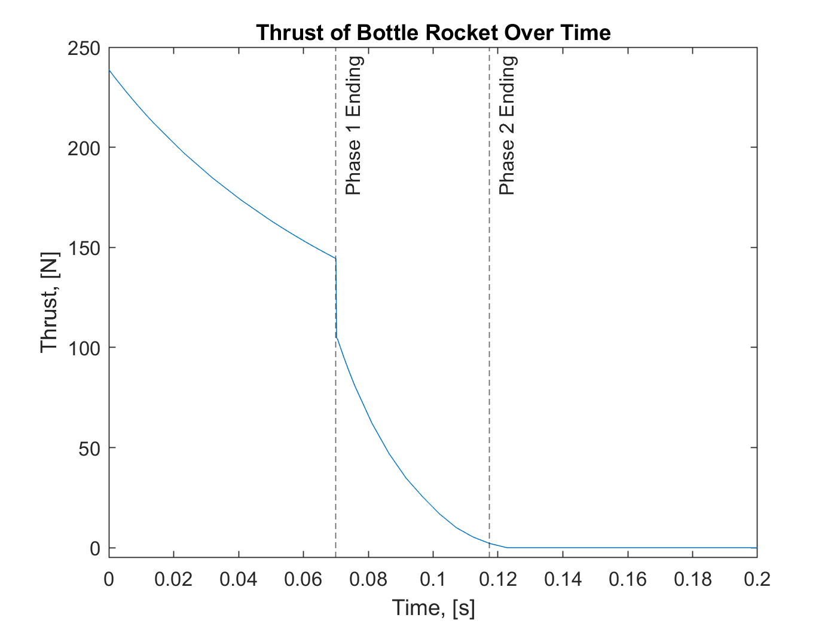
Results

Slide 9
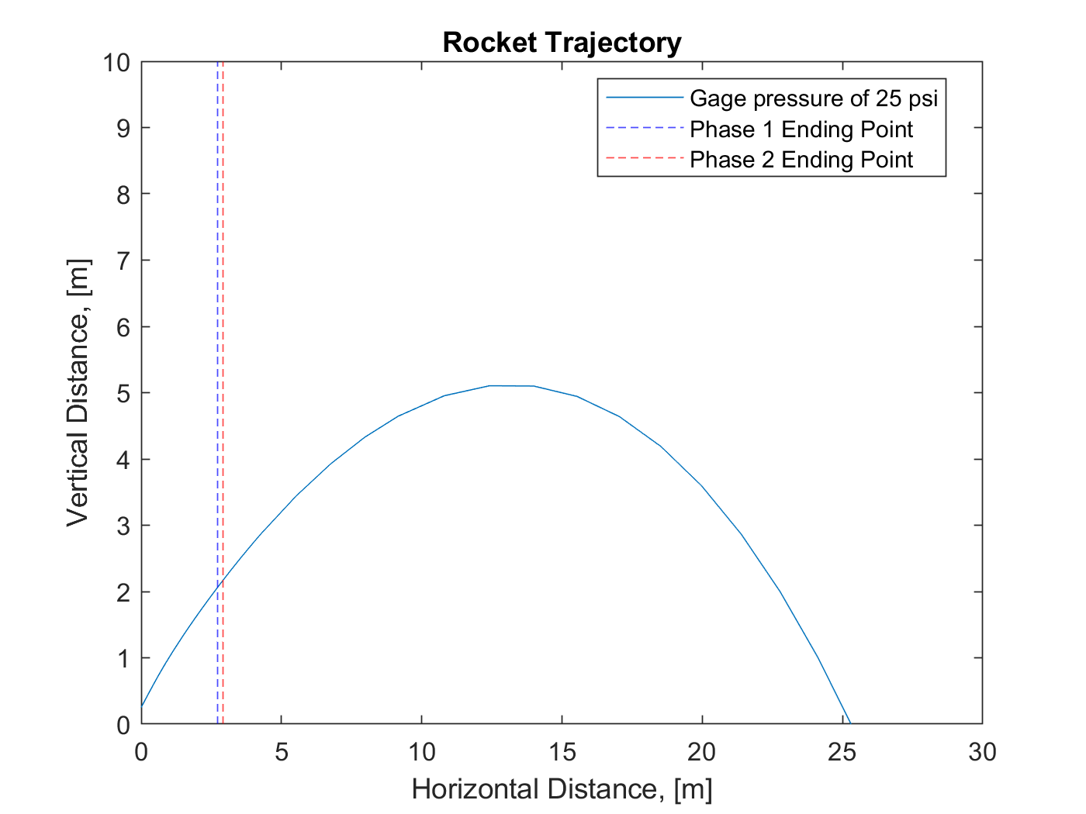
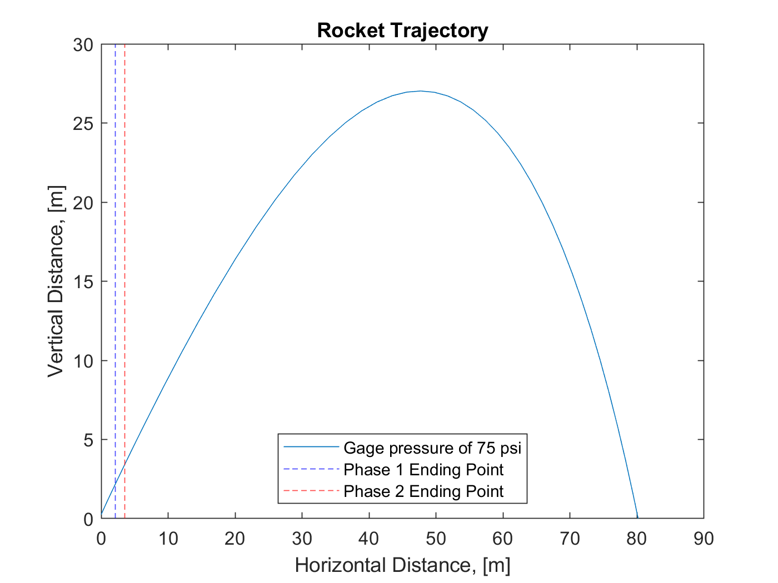
Discussion
Effect that initial pressure of air has on Bottle Rocket:

Slide 10
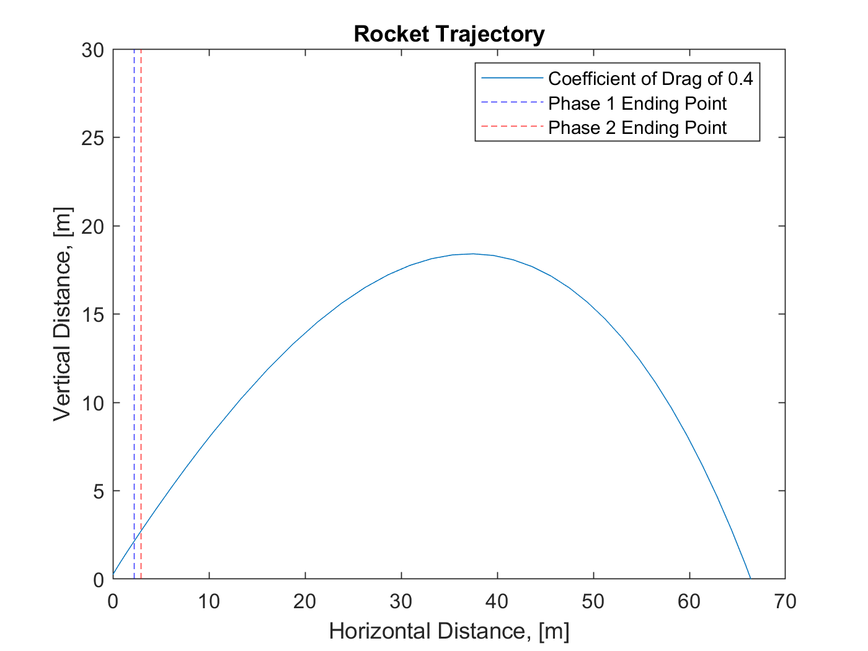
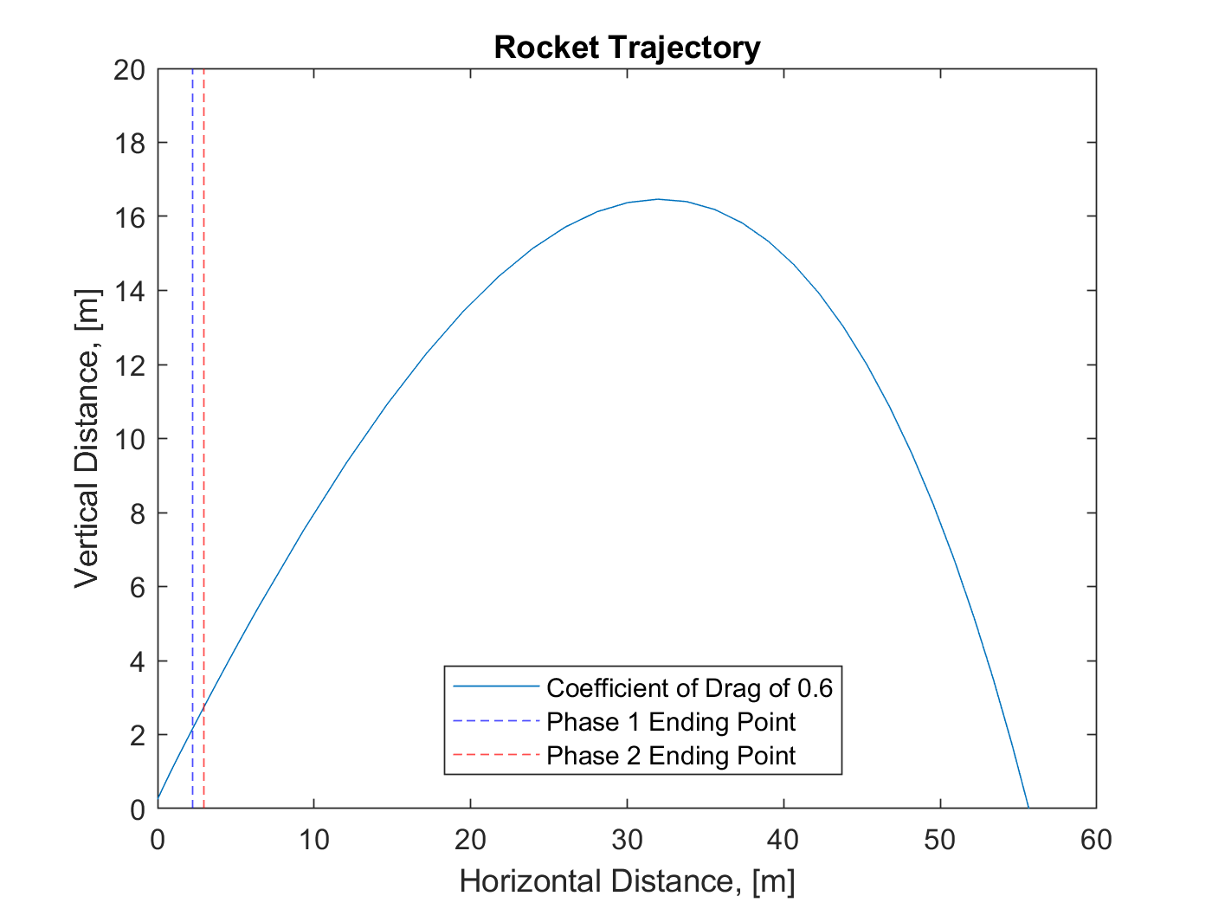
Discussion
Effect that drag coefficient has on Bottle Rocket.

Slide 11
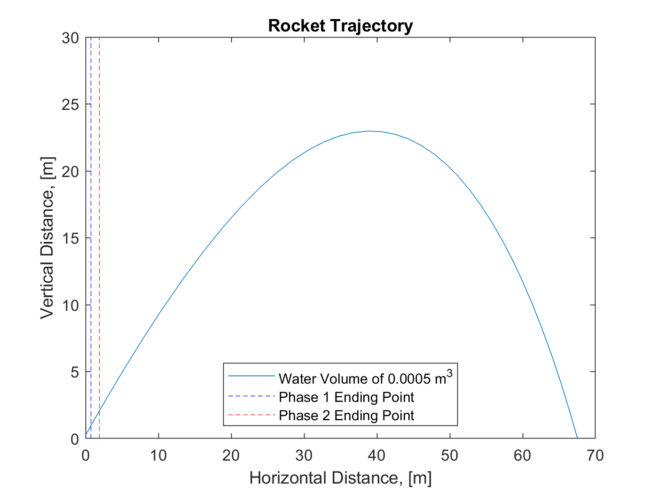
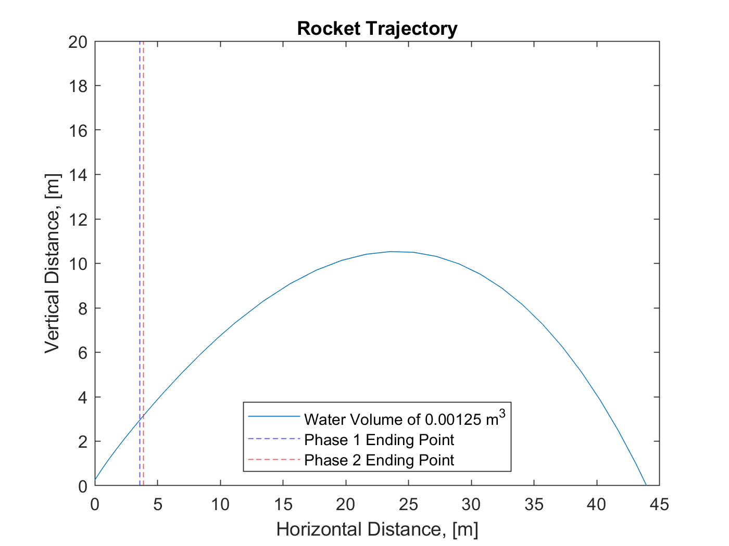
Discussion
Effect that initial volume of water has on Bottle Rocket:

Slide 12
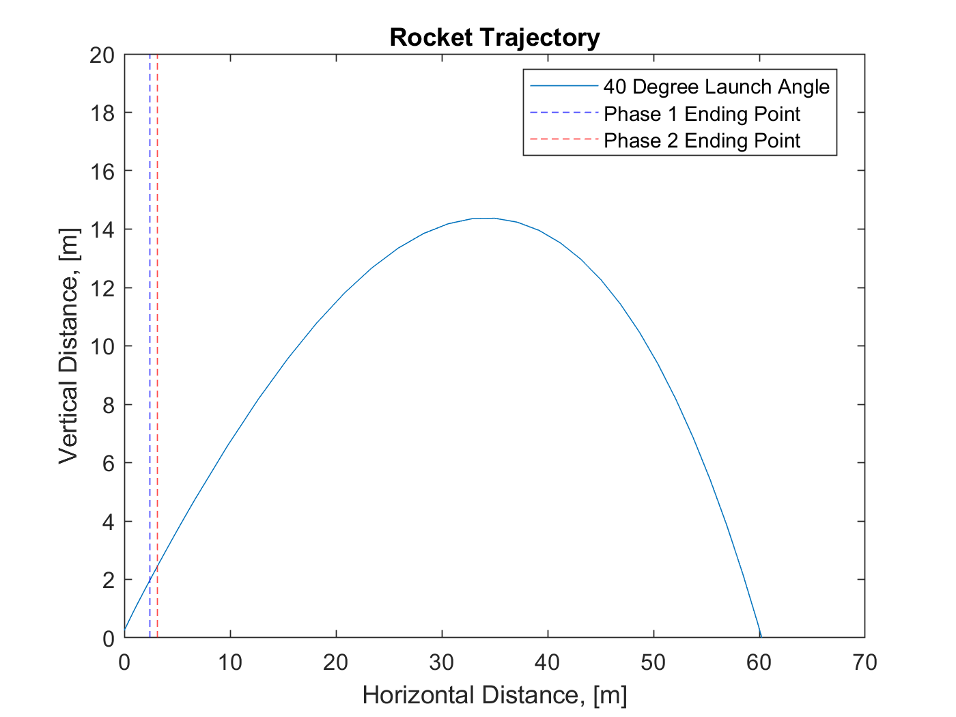
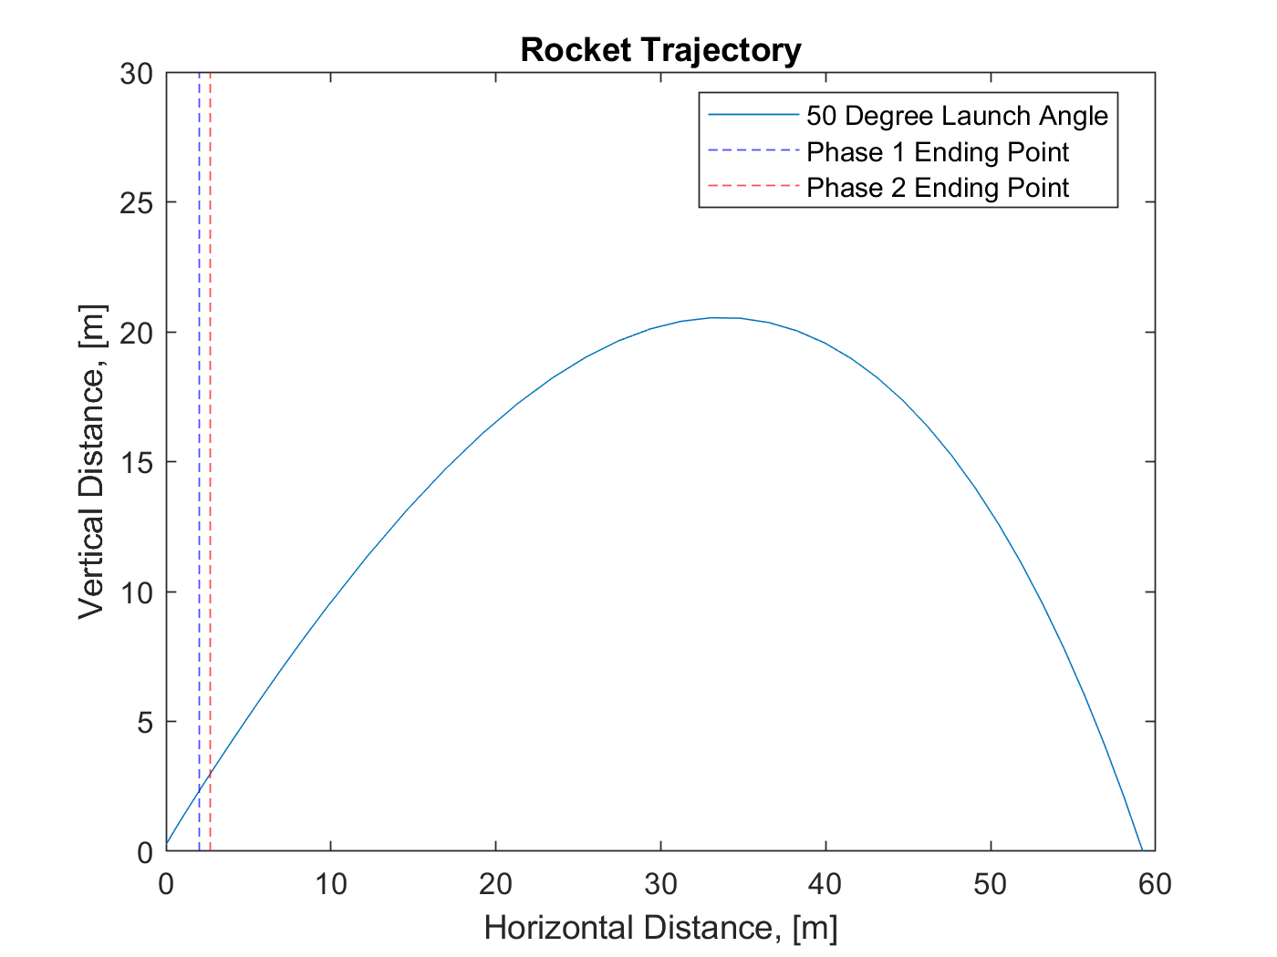
Discussion
Effect that launch angle has on Bottle Rocket.

Slide 13
Conclusion - Tradeoffs
There are Many variables that can be altered, and the initial pressure is the most effective.
Launch angle is optimal at 45 degrees.
Importance of different parameters
Importance of modeling.

Slide 14
References
Anderson, A. P., “ASEN2012 - Project 2 - Bottle Rocket Design - 2019,” Experimental and Computational Methods ASEN 2012 [online database], [retrieved 7 December 2019].
Anderson, A. P., “Project 2 - Additional Verification Plots,” Experimental and Computational Methods ASEN 2012 [online database], [retrieved 7 December 2019].
Anderson, A. P., “VerificationCaseForProject2” Experimental and Computational Methods ASEN 2012 [online database], [retrieved 7 December 2019].
Anderson, J. D., Jr., Introduction to Flight, 7th Ed., McGraw-Hill (2009).
Sutton, G. and Biblarz, O., Rocket Propulsion Elements, 8th Ed., Wiley (2010).

Slide 15
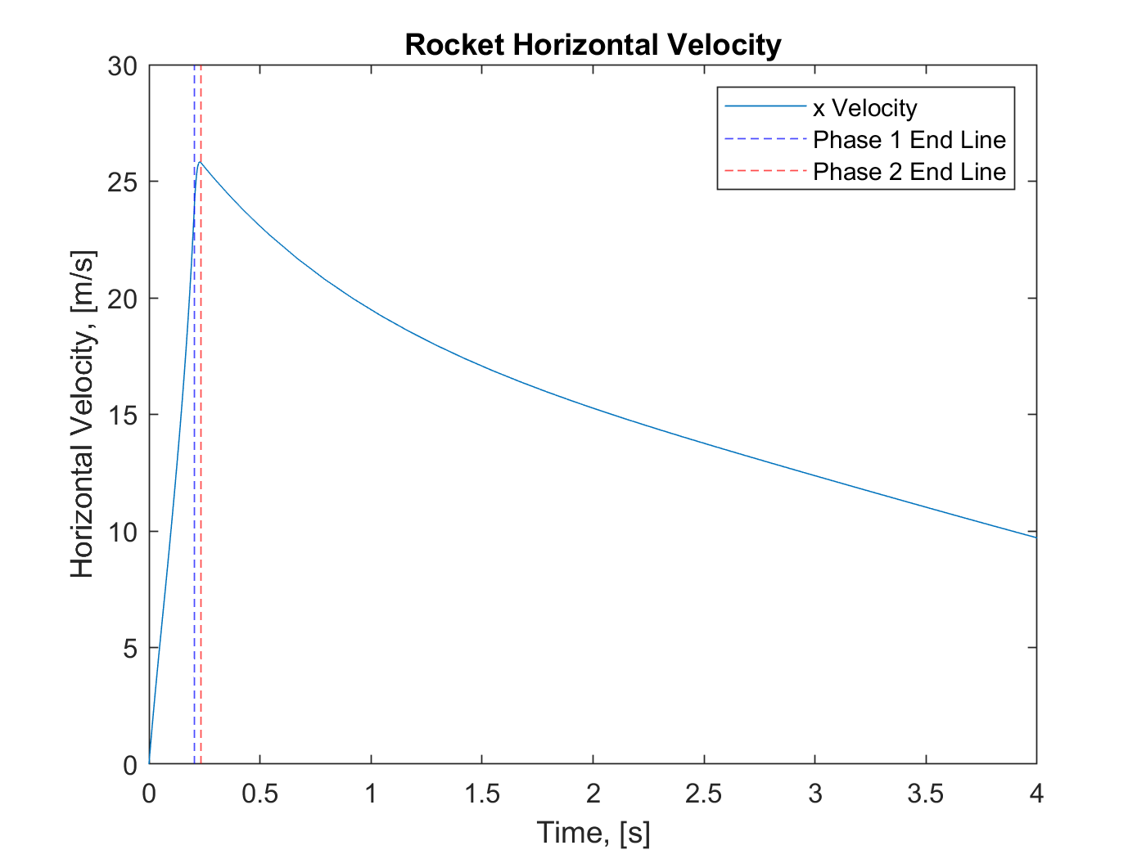
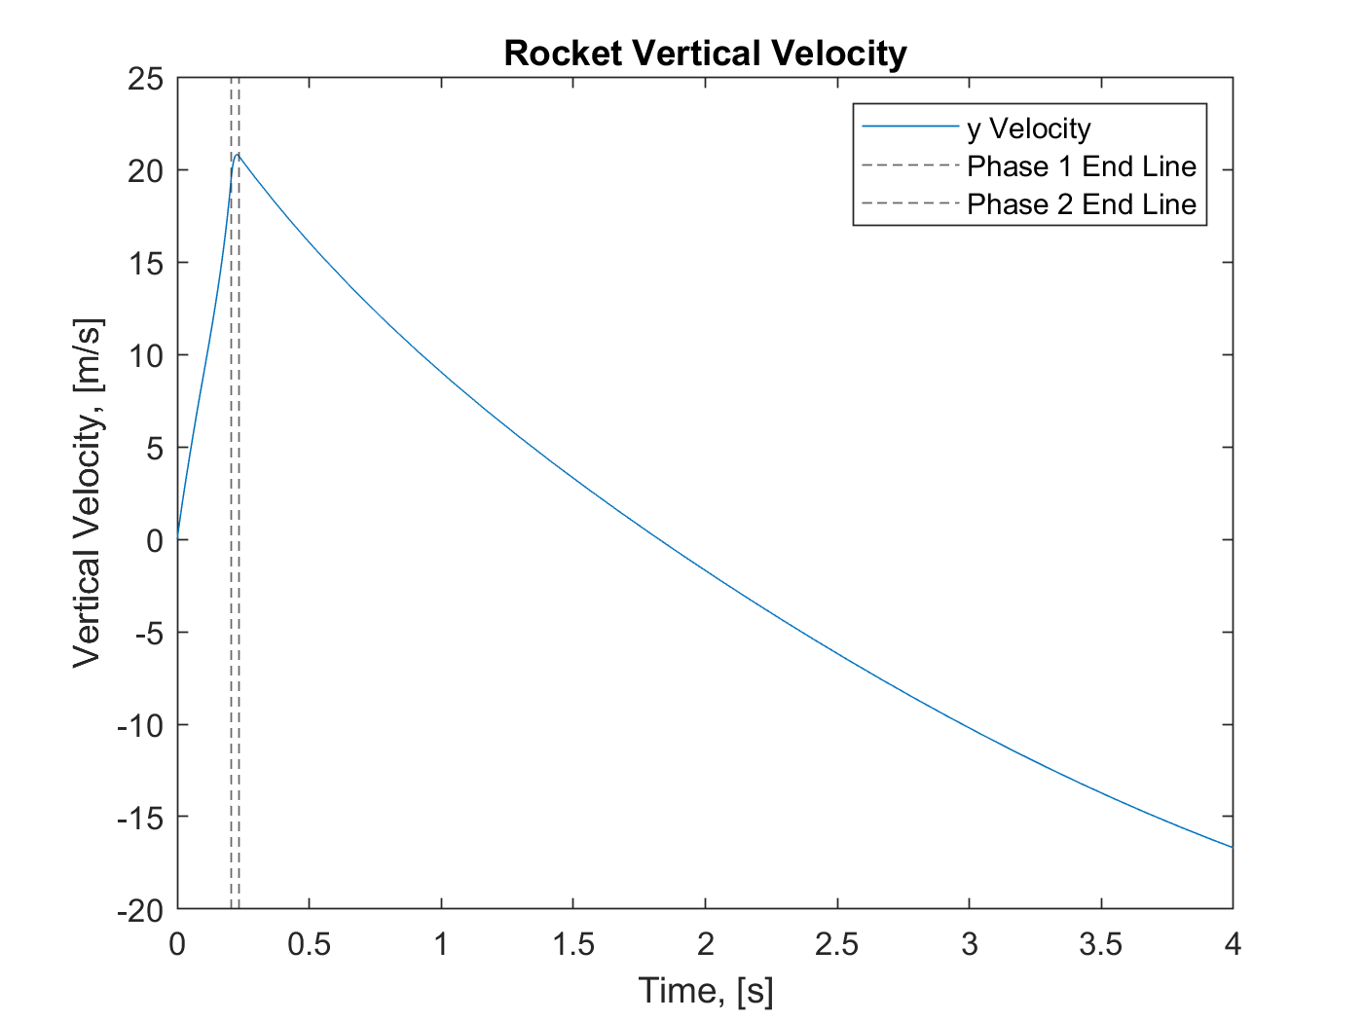
Backup Slides - Verification Case

Slide 16
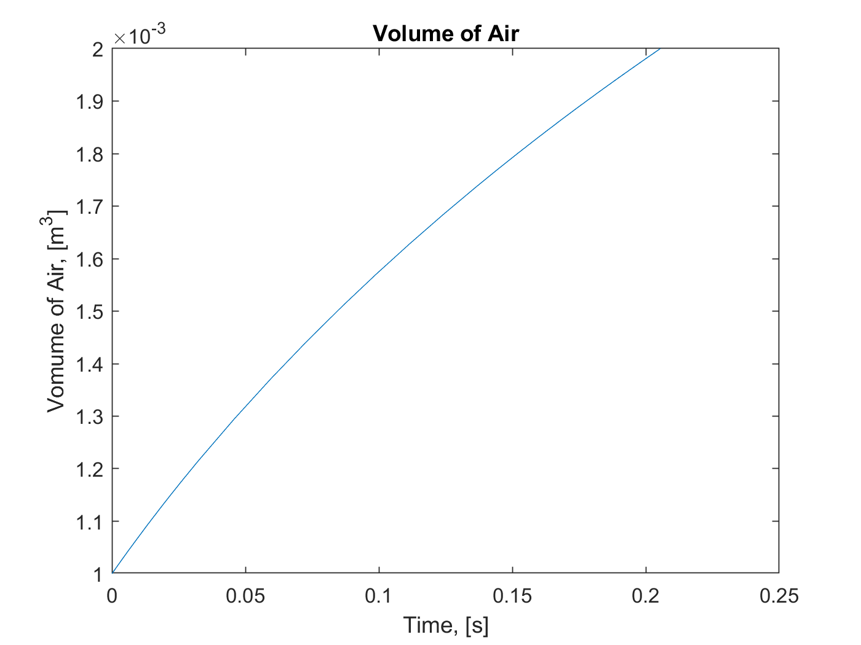
Backup Slides - Verification Case

Slide 17
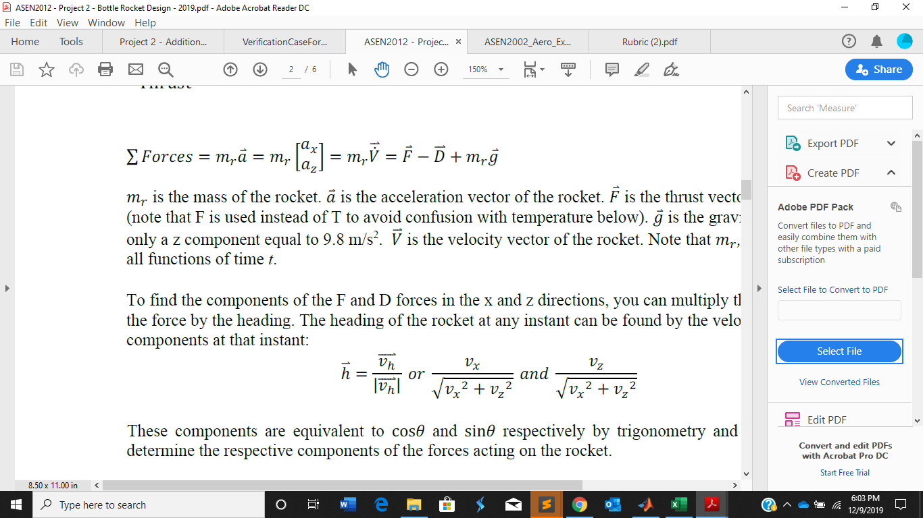
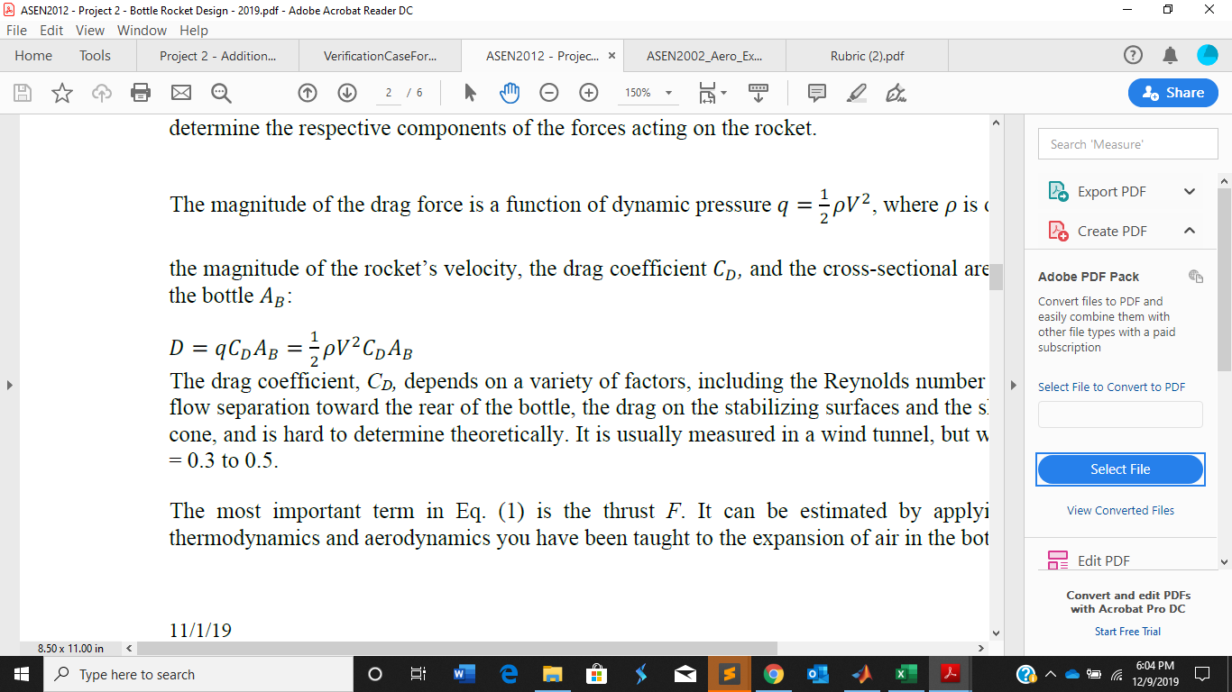
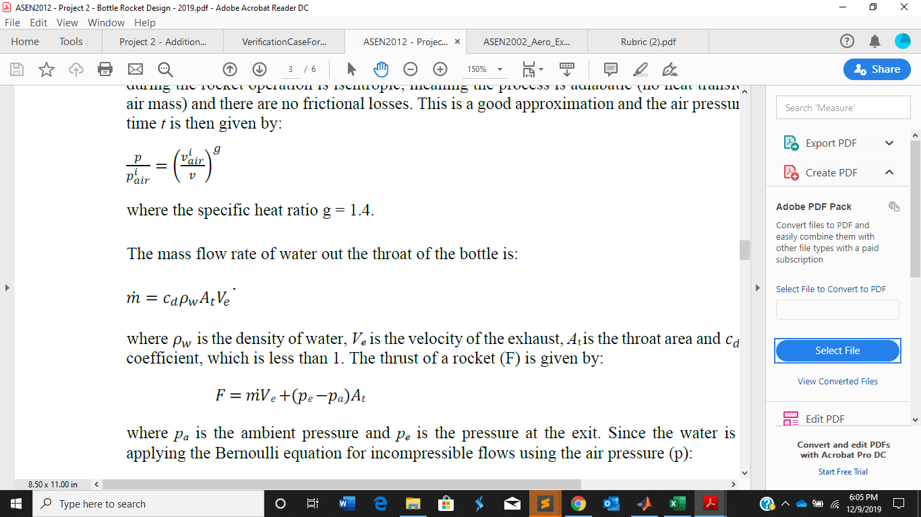
Backup Slides

Slide 18
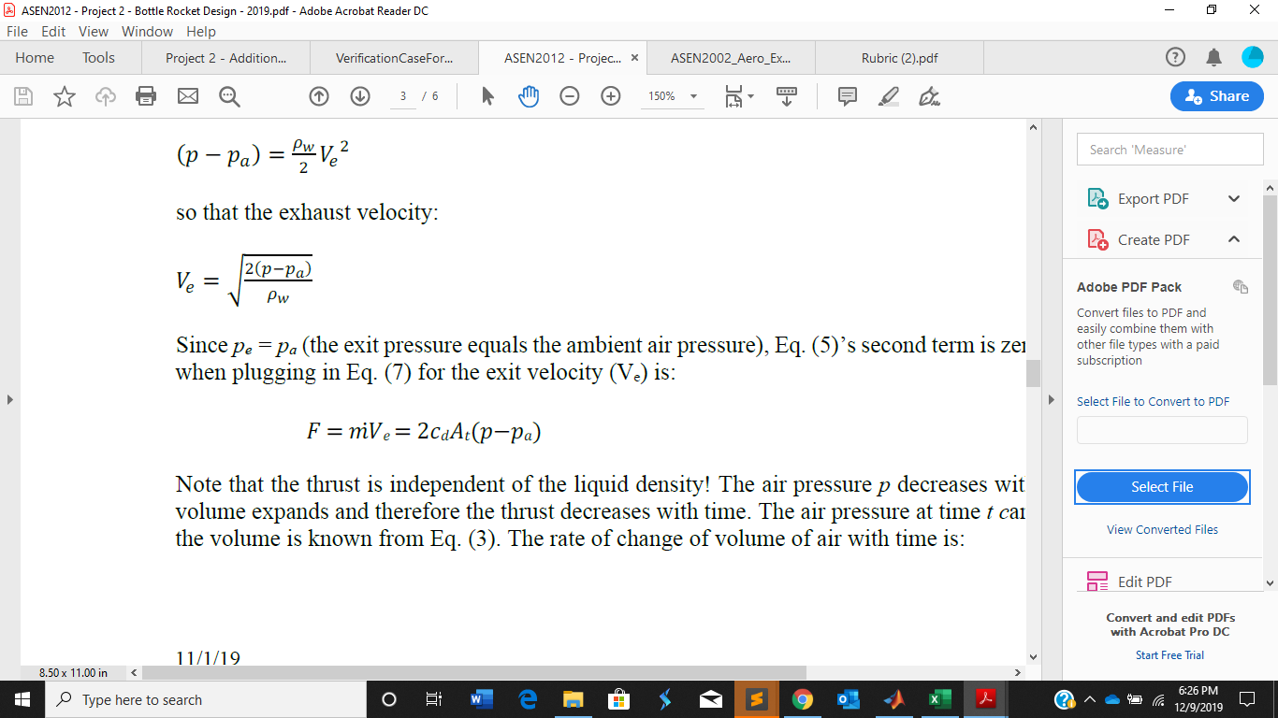
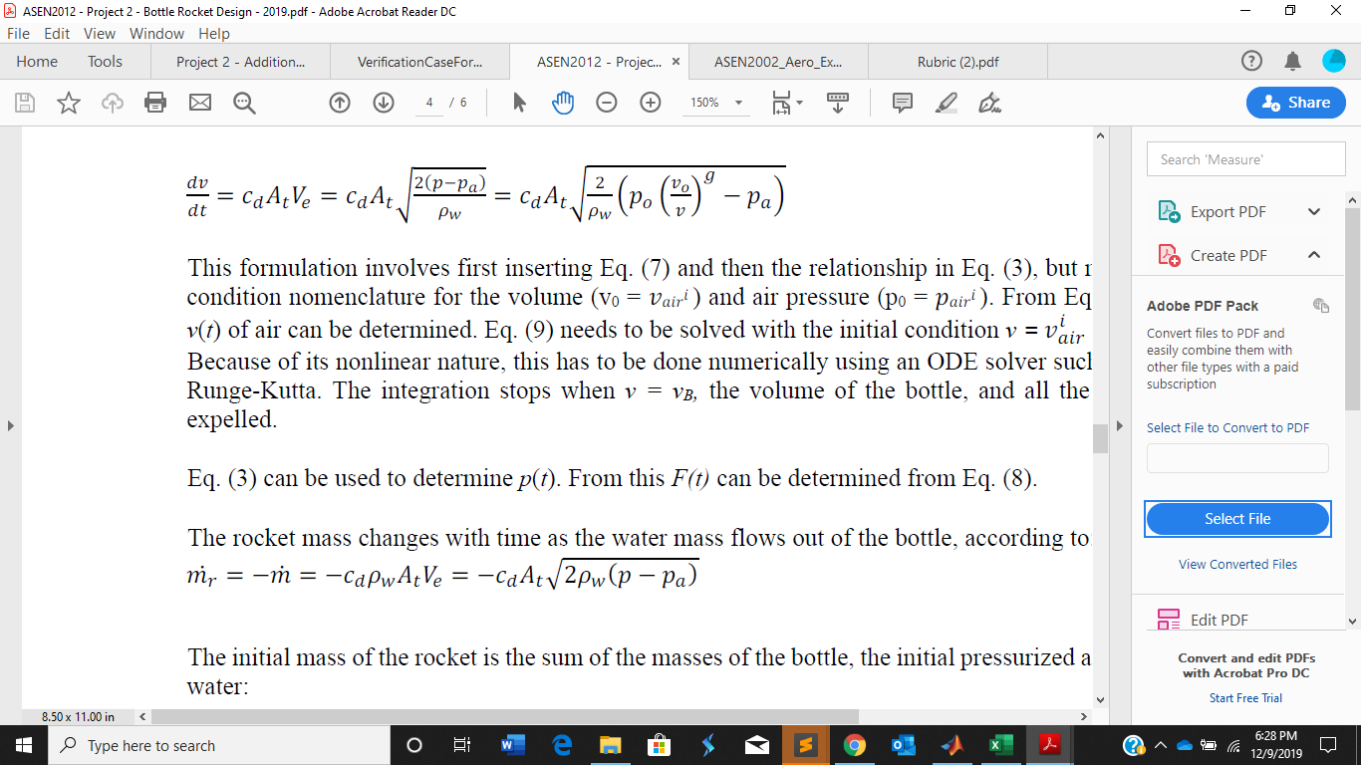
Backup Slides - Phase 1

Slide 19

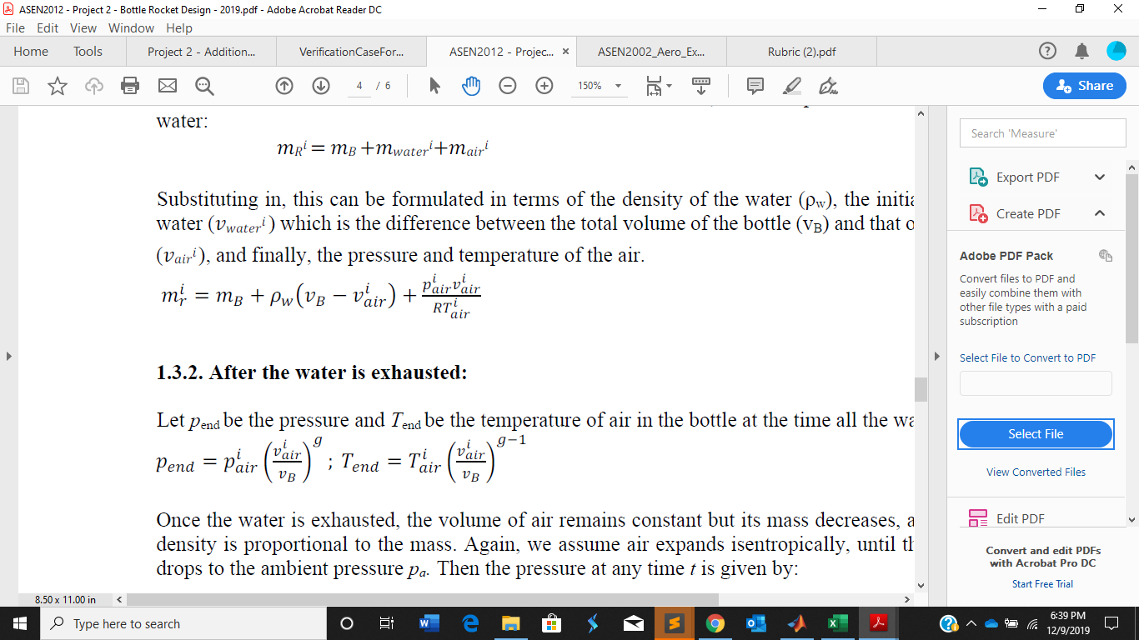
Backup Slides - Phase 1

Slide 20
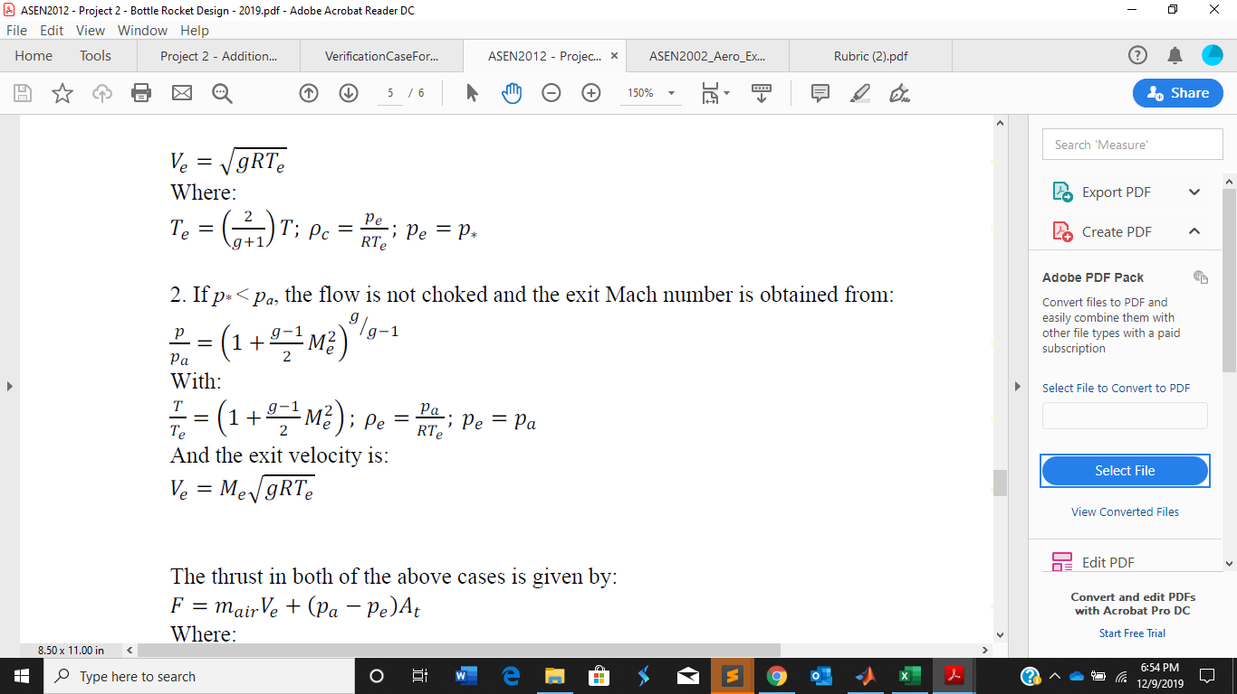
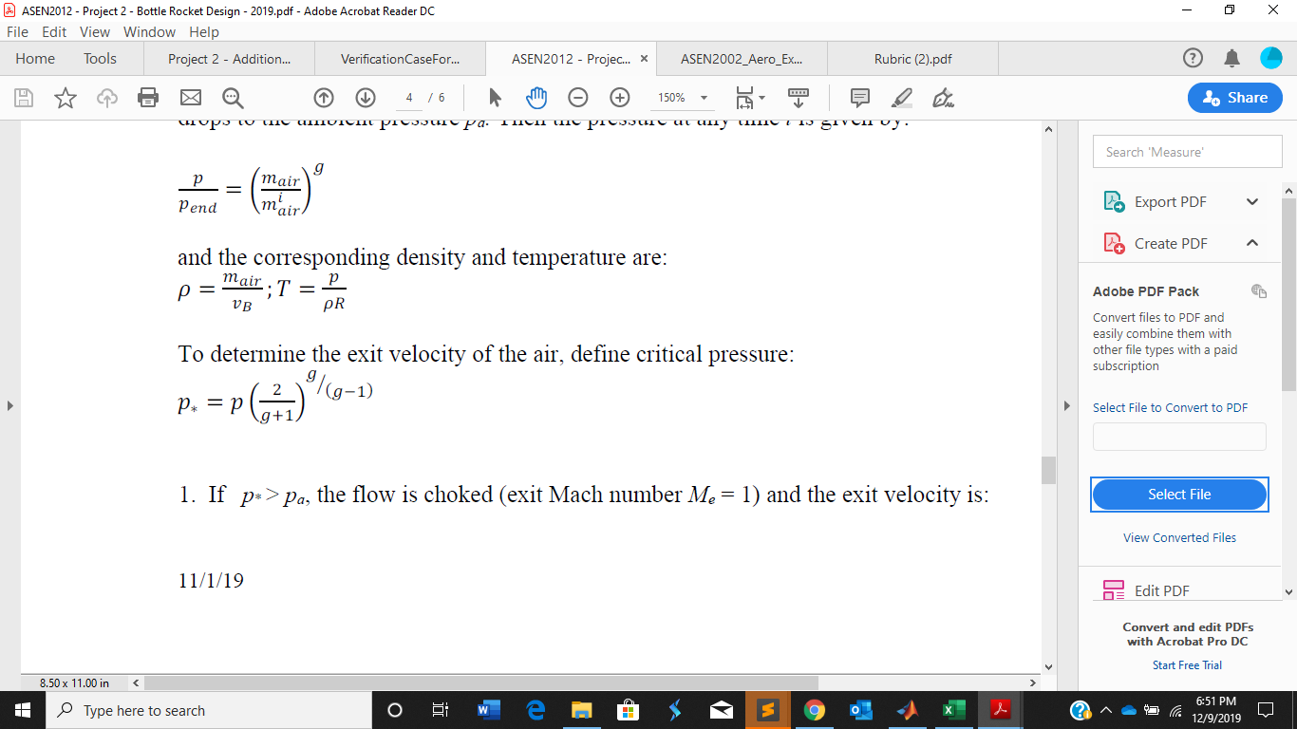
Backup Slides - Phase 2 - choked

Slide 21
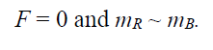
Relevant Equations - Phase 3

Slide 22
Flowchart
START
Create main function that derives variables for phase 1 and 2
Call Ode45 to integrate function
Pass in initial conditions
Find thrust vector
When is Vbottle = Vair
Call Truss2vec function
Assign time and data variables
Time this occurs?
Is there Choked flow?
Yes
Yes: choked flow equations
No
End
Plot thrust

Slide 23
Flowchart
START
Read in static test stand data
Create main function that derives variables for phase 1 and 2
Call Ode45 to integrate function
Find thrust vector
When is Vbottle = Vair
Call Truss2vec function
Assign time and data variables
Time this occurs?
Is there Choked flow?
Yes
Yes: choked flow equations
No
End
Plot thrust

